Slide 1
Analysis and Characterization of Community Projects for Resilience Innovations in Climate Resilience March 28th, 2023 Session B1
Notes:
Please limit background material, site descriptions, and information about standard methods to the first few minutes—use the remaining time to cover unusual aspects of the work and the results and conclusions.
NOTE: A confidence monitor will be placed on the floor in front of the podium. Only the current slide will be seen on the monitor, speaker notes will not be visible. Please bring your speaker notes with you, if needed.

Slide 2
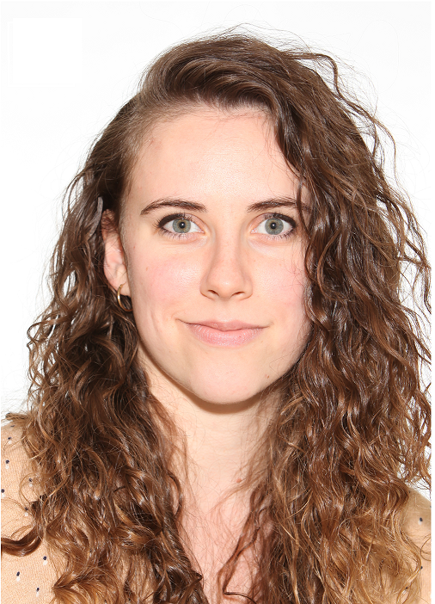
Hello there!
Molly F. Jenkins
Oak Ridge Institute for Science & Education Participant
Hosted at the United States Environmental Protection Agency
Office of Research and Development
Center for Public Health and Environmental Assessment

Slide 3

A R U P & R O C K E F E L L E R ‘ S C I T Y R E S I L I E N C E I N D E X
As one of the UN's Sustainable Development Goals, city resilience is now accepted as a critical urban agenda. But how can we make resilience tangible and practical for cities? How can resilience be applied by cities to build sound strategies and prioritise investments?
Notes:
Background of problem – cities need to start adapting in-situ NOW, regardless of whether or not there is buy-in on the specific theoretical (and ideologically loaded) ideas surrounding climate change. Can we build a well-vetted framework and then use it to build a truly user-friendly tool to facilitate adaptation and support networks between communities facing similar challenges? I turned to the most influential research and reports of the past 20 years to understand how researchers are defining resilience at the community scale.
How can we connect clearly defined resilience theory to practice?
What are the priorities of a given community in America?
How do communities approach resilience?
Is there a disconnect between resilience theory and community practice?
We don’t pretend to answer these questions to perfect completion in our study. But we do offer at minimum a few ways that we can begin to answer and express curiosity in these questions.
These are critical questions we need to address if we want to build and promote resources for effective resilience planning.
Understand your audience!

Slide 4

OUR OBJECTIVE: INFORM PRACTICAL RESILIENCE APPLICATIONS
Evaluate and synthesize resilience literature, informing an experimental resilience lexicon that can be used to proxy indicators of community resilience from text
Evaluate and synthesize community priorities independent of resilience classification using basic Natural Language Processing methods
Evaluate overlap between experimental resilience lexicon and control community lexicon
Notes:
Background of problem – cities need to start adapting in-situ NOW, regardless of whether or not there is buy-in on the specific theoretical (and ideologically loaded) ideas surrounding climate change. Can we build a well-vetted framework and then use it to build a truly user-friendly tool to facilitate adaptation and support networks between communities facing similar challenges? I turned to the most influential research and reports of the past 20 years to understand how researchers are defining resilience at the community scale.
How can we connect clearly defined resilience theory to practice?
What are the priorities of a given community in America?
How do communities approach resilience?
Is there a disconnect between resilience theory and community practice?
We don’t pretend to answer these questions to perfect completion in our study. But we do offer at minimum a few ways that we can begin to answer and express curiosity in these questions.
These are critical questions we need to address if we want to build and promote resources for effective resilience planning.
Understand your audience!

Slide 5
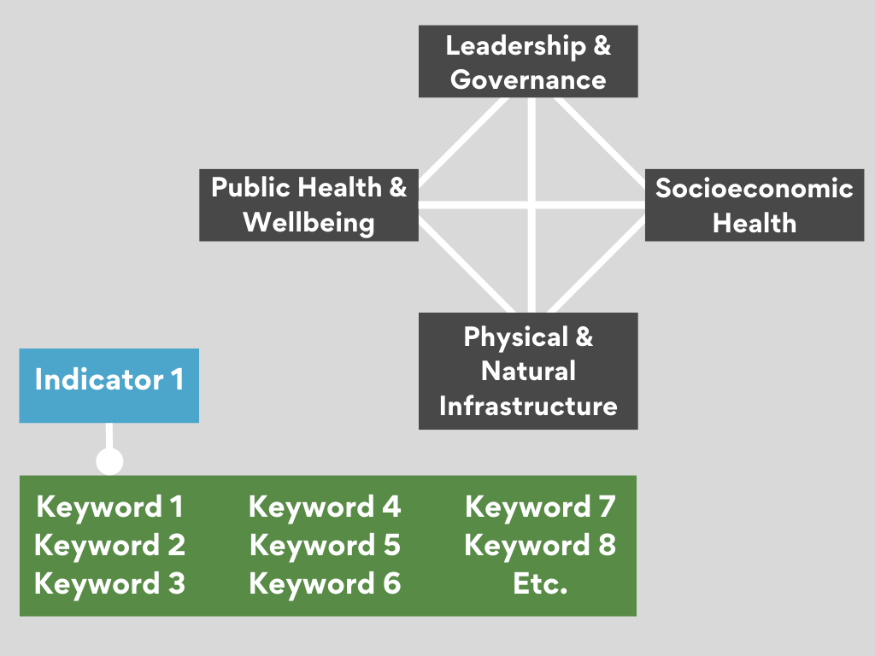
Identification of common resilience criteria, adapted from ARUP & Rockefeller Foundation’s City Resilience Index

Slide 6
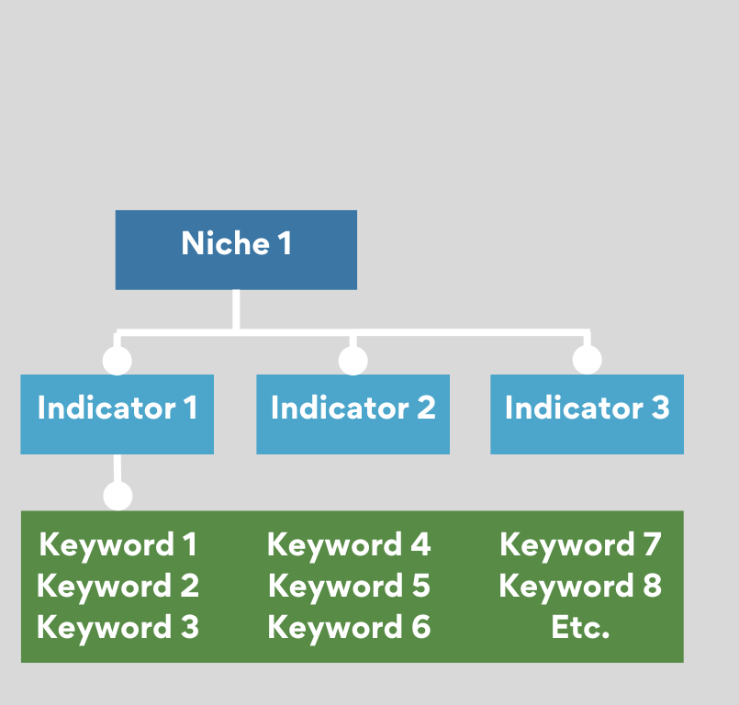
Clear precedent: Elsevier Sustainable Development Goal Research Mapping Initiative
Large text database of project names and abstracts
keywords used as proxies for indicators
a bottom-up approach
Manual querying AND auto-computational methods
Social sciences with mixed-methods approach

Slide 7
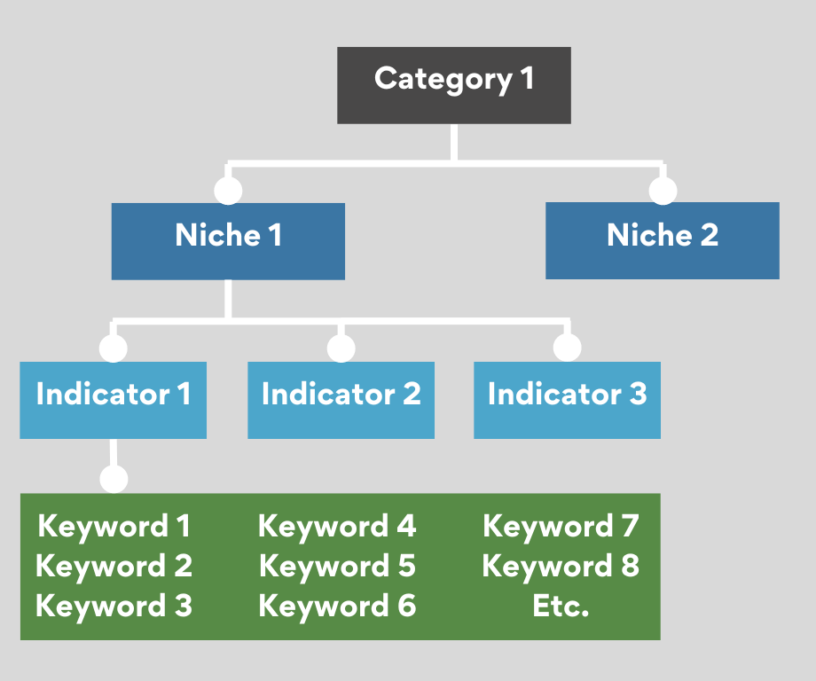
Use of expert familiarity with literature, synthesis of literature to inform manual and computer-assisted coding & querying of case studies in a database of community projects (n = unique project abstracts)
Development of Experimental Lexicon for Community Resilience
Evaluation against a Control Lexicon using Natural Language Processing

Slide 8
Methods: Analysis 1
for(s in searchterms){ #for each search term
abstract_match = str_subset(as.character(case_studies$Project.Abstract),
regex(s, ignore_case = TRUE)) #with match in abstract or project name
name_match = str_subset(as.character(case_studies$Project.Name),
regex(s, ignore_case = TRUE))
matched_categories = #give me a subset dataframe with the case studies
case_studies %>% #where the project name OR abstract match with the search results filter(Project.Name %in% name_match | Project.Abstract %in% abstract_match) %>%
mutate(category = c, #include the broader resilience category & search term
niche = n,
keyword = s,
name = Project.Name,
abstract = Project.Abstract)
Notes:
Straightforward approach once we had the search terms and the project database of case studies: cycle through each search term, scanning the entire database for project names and abstracts containing that search term. When located, the project name and abstract, as well as the search term and corresponding resilience niches and categories, are saved in a row. The rows are stacked as the function loops through each subsequent search term, building a new dataframe. We can then use this information to re-examine flagged projects in greater detail, evaluating their resilience profiles and overall text using natural language processing methods and key word frequencies.

Slide 9
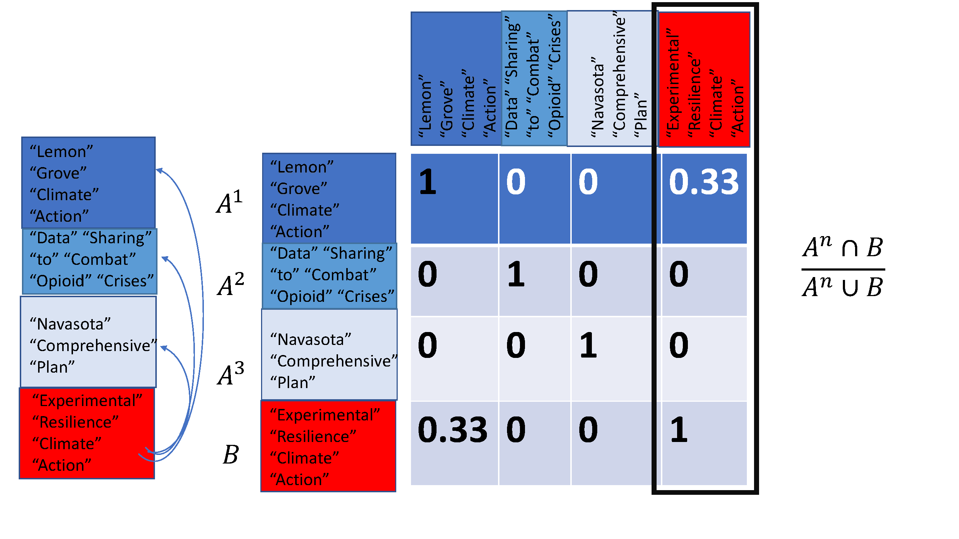
Methods: Analysis 3
Evaluation of Experimental and Control Lexicons
Text similarity using Jaccard’s similarity index
Notes:
Now trying to do this by hand would be a nightmare. And doing it in excel leaves too much room for human error (accidental manipulation of raw data during tabulation). So we turned to R to quickly run though all of these search terms and flag projects.

Slide 10
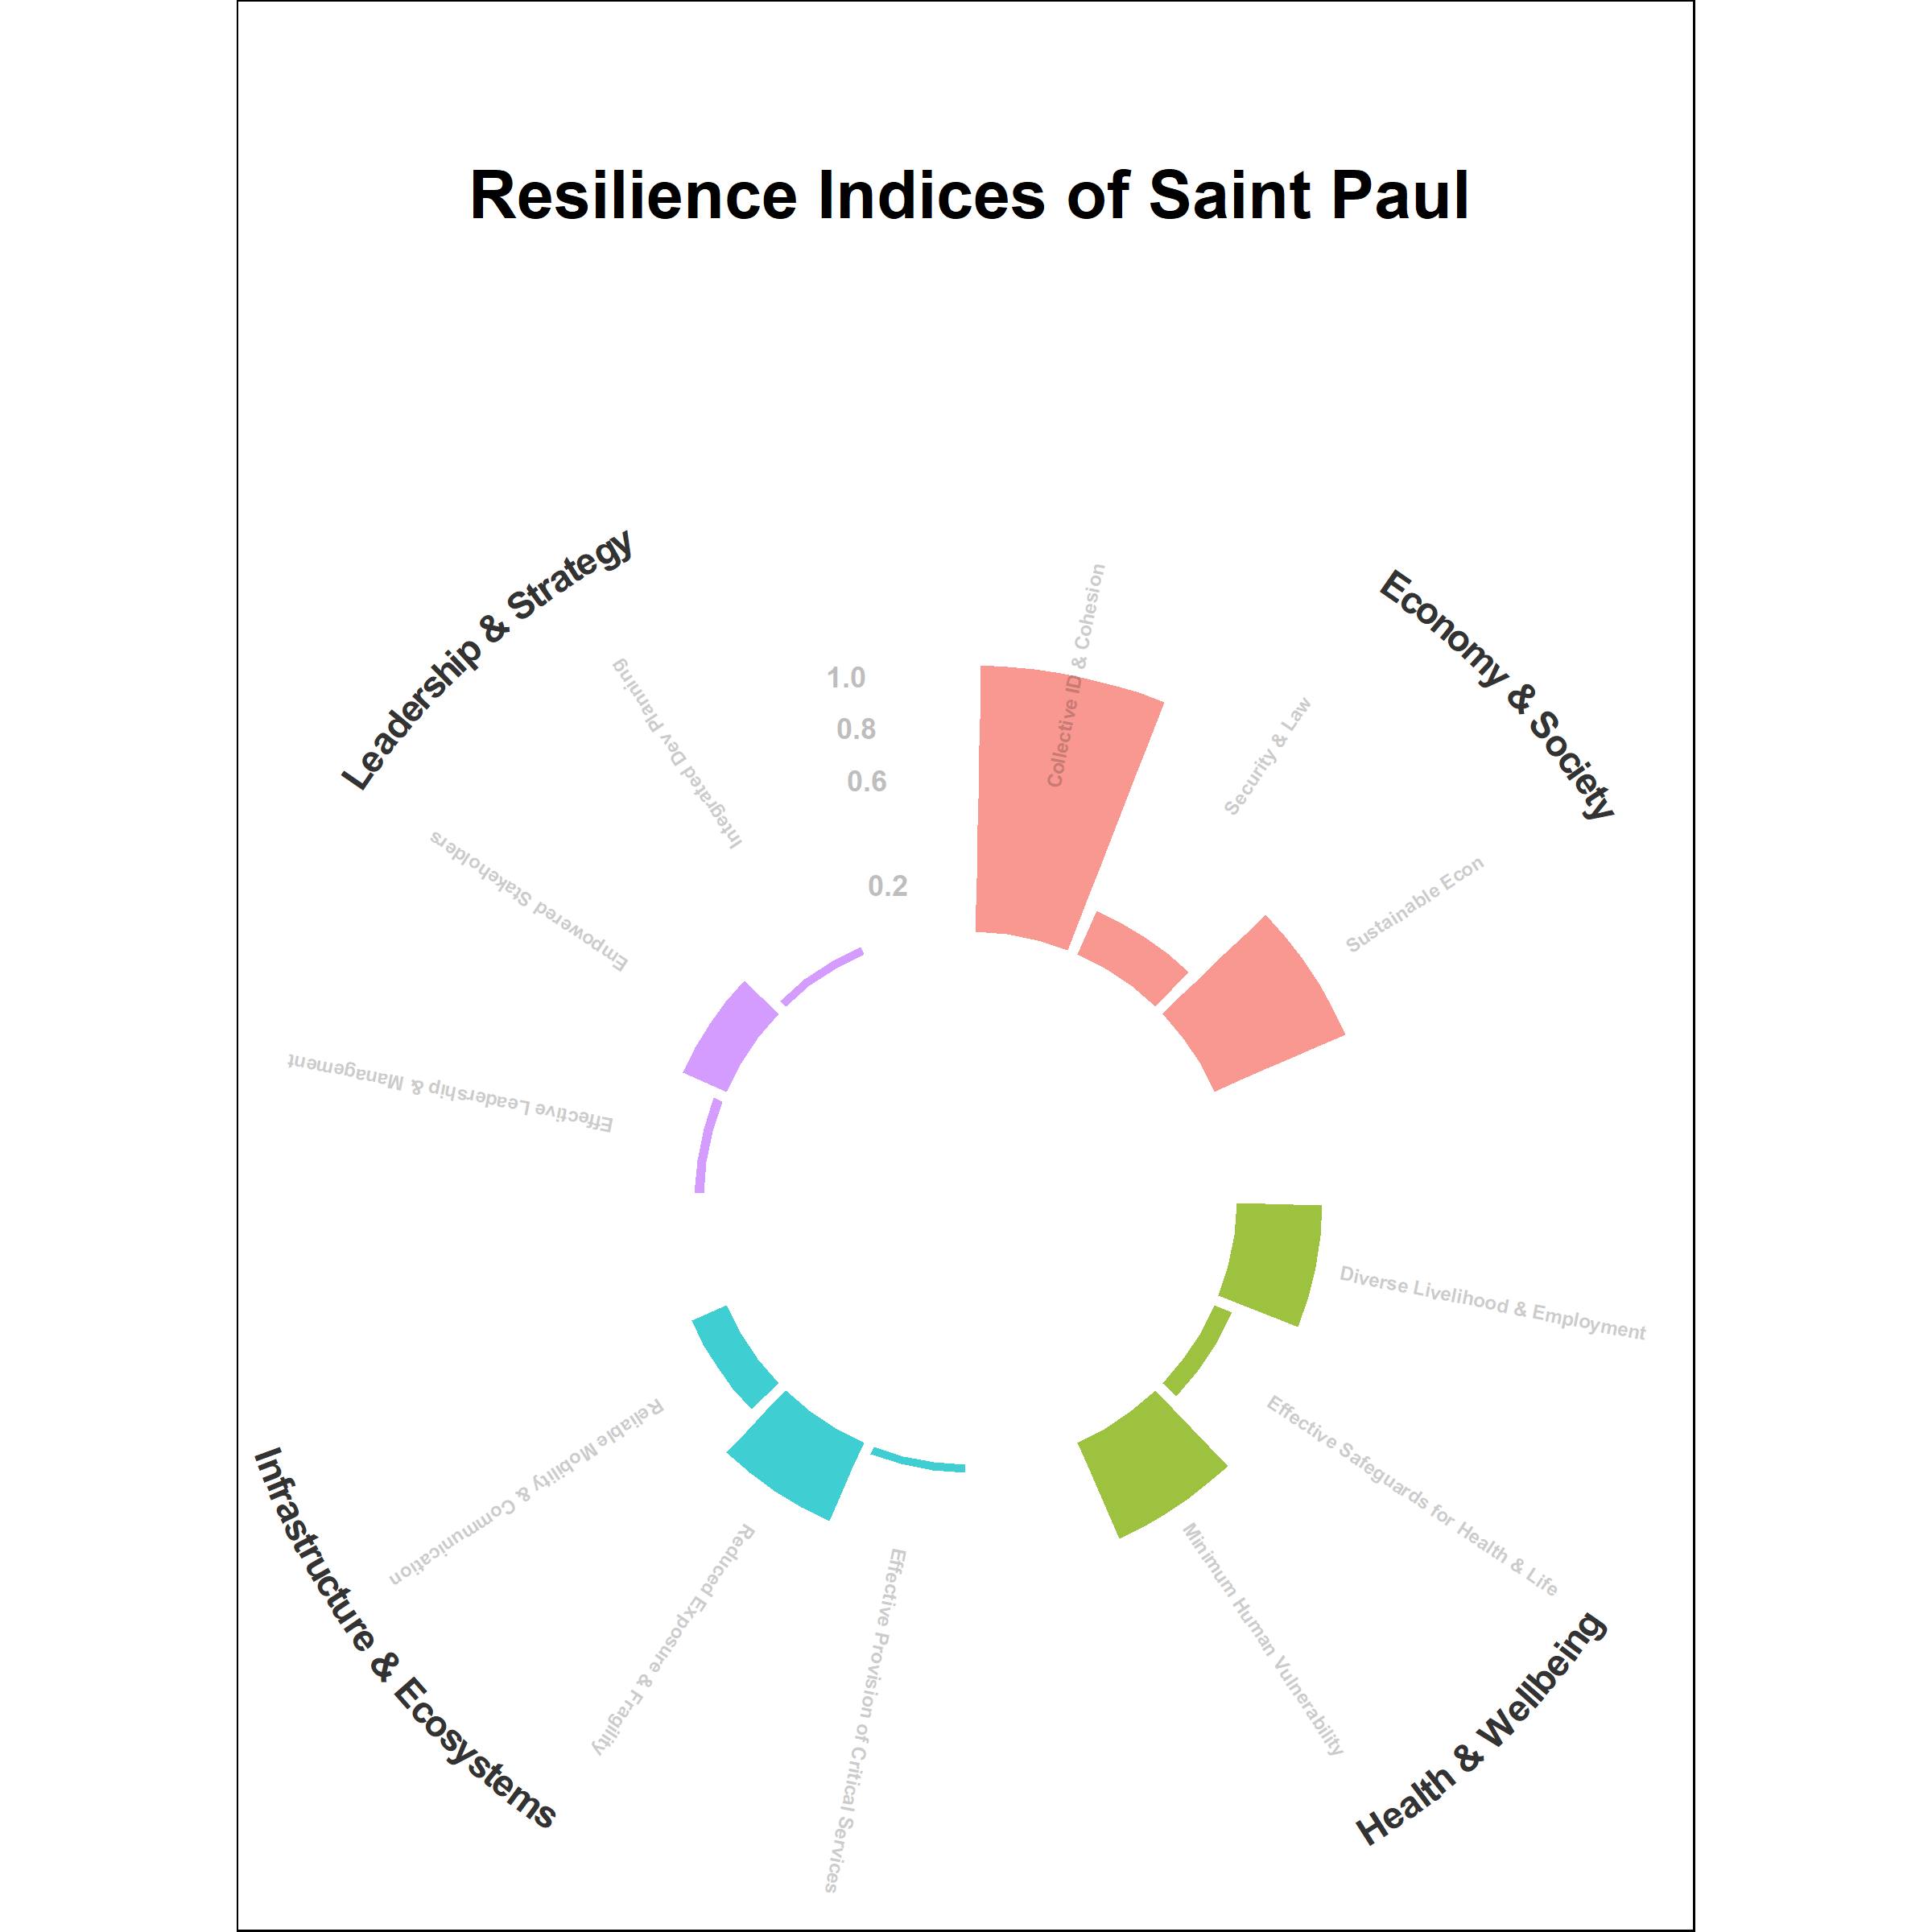
Results: Analysis 1
Of the case studies we coded and evaluated, 40 communities in particular stood out for a combination of:
meeting a relatively high number of coding queries
Geographic and community diversity represented
Notes:
Top priorities outlined from within the resilience lens? List out:

Slide 11
Results: Analysis 1
Notes:
Resilience key words with highest rankings vs control with highest rankings, breakdown of # of projects, % of total project database

Slide 12
Results: Analysis 1
Notes:
Resilience key words with highest rankings vs control with highest rankings, breakdown of # of projects, % of total project database

Slide 13
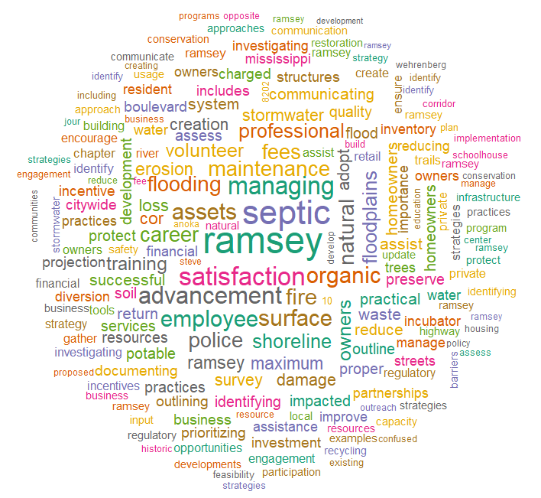
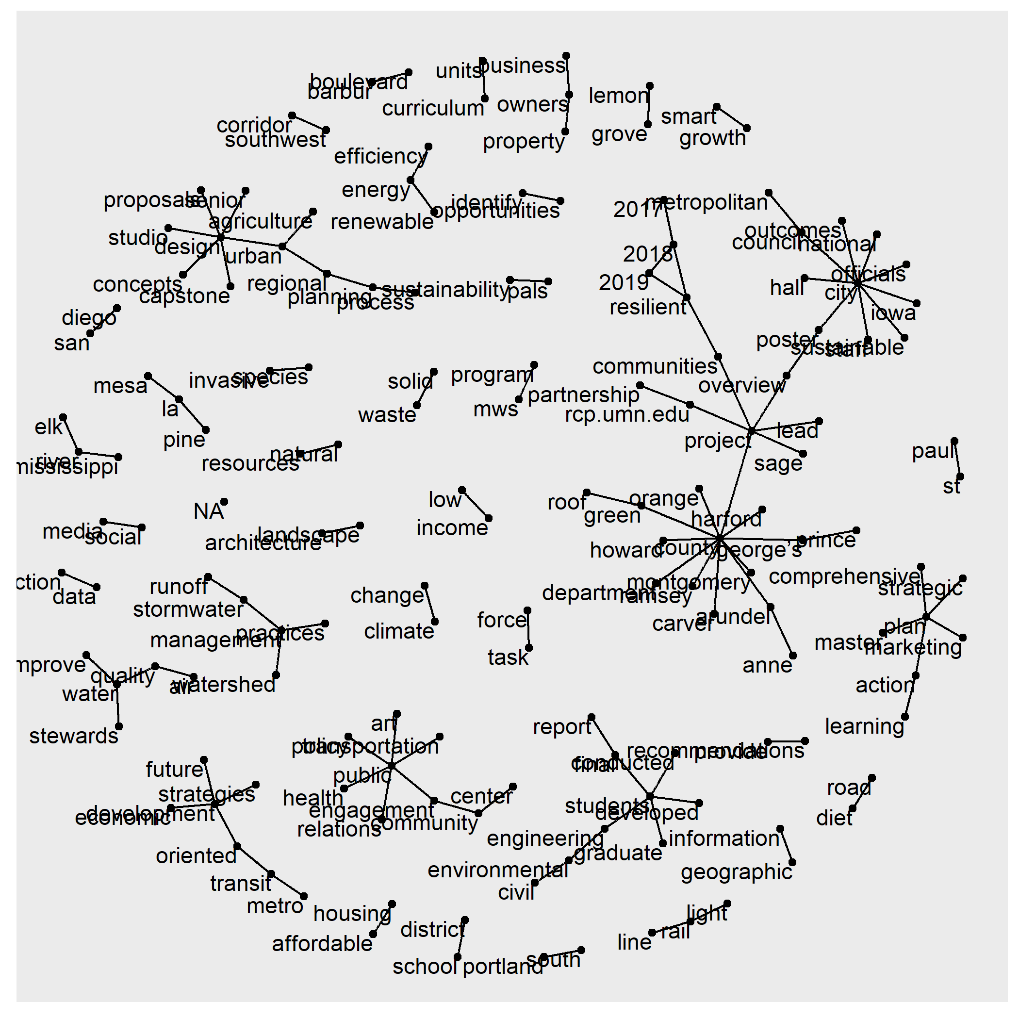
Results: Analysis 2
Notes:
Clear geographic, site-specific nature of these projects – spatially explicit concerns demand spatially explicit solutions.
Top priorities on their own? Water, watersheds, stormwater runoff, septic and sewer management,

Slide 14
Results: Analysis 2
Notes:
Clear geographic, site-specific nature of these projects – spatially explicit concerns demand spatially explicit solutions.
Top priorities on their own? Water, watersheds, stormwater runoff, septic and sewer management,

Slide 15
Results: Analysis 2
Notes:
Draft control vs resilience experimental, n’s and tf-idf

Slide 16
Results: Analysis 2
Notes:
Draft control vs resilience experimental, n’s and tf-idf

Slide 17
Results: Analysis 3
Jaccard’s similarity index table:
Topic models were not encouraging either!

Slide 18
OUR OBJECTIVE: INFORM PRACTICAL RESILIENCE APPLICATIONS
Clear mismatch in the specific words/phrases used by communities in their projects and the language used to describe community resilience in the research literature.
Potential categorical overlap and latent emergence of governing topics -> Future testing
What CATEGORIES/TOPICS arise organically from the text, and are they similar to the main resilience categories?
Coupled machine-learning methods & focus groups
Notes:
Background of problem – cities need to start adapting in-situ NOW, regardless of whether or not there is buy-in on the specific theoretical (and ideologically loaded) ideas surrounding climate change. Can we build a well-vetted framework and then use it to build a truly user-friendly tool to facilitate adaptation and support networks between communities facing similar challenges? I turned to the most influential research and reports of the past 20 years to understand how researchers are defining resilience at the community scale.
How can we connect clearly defined resilience theory to practice?
What are the priorities of a given community in America?
How do communities approach resilience?
Is there a disconnect between resilience theory and community practice?
We don’t pretend to answer these questions to perfect completion in our study. But we do offer at minimum a few ways that we can begin to answer and express curiosity in these questions.
These are critical questions we need to address if we want to build and promote resources for effective resilience planning.
Understand your audience!

Slide 19
OUR OBJECTIVE: INFORM PRACTICAL RESILIENCE APPLICATIONS
Research informs the practical application of a public Community Resilience Assessment and Planning Storymap, with paired case studies and corresponding national-extent standardized data.
Notes:
Background of problem – cities need to start adapting in-situ NOW, regardless of whether or not there is buy-in on the specific theoretical (and ideologically loaded) ideas surrounding climate change. Can we build a well-vetted framework and then use it to build a truly user-friendly tool to facilitate adaptation and support networks between communities facing similar challenges? I turned to the most influential research and reports of the past 20 years to understand how researchers are defining resilience at the community scale.
How can we connect clearly defined resilience theory to practice?
What are the priorities of a given community in America?
How do communities approach resilience?
Is there a disconnect between resilience theory and community practice?
We don’t pretend to answer these questions to perfect completion in our study. But we do offer at minimum a few ways that we can begin to answer and express curiosity in these questions.
These are critical questions we need to address if we want to build and promote resources for effective resilience planning.
Understand your audience!

Slide 20


Acknowledgements
Special thanks to Jessica Daniel, Jose Zambrana, Laura Bloch, Marshall Curry, and Federal Service interns as core members of the project team.

